Slide 1
Phonics
Best Practice

Slide 2
Organising each taught session to cover essential elements; Revise, Teach, Practice, Apply + (Assess)

Slide 3
Monitoring learning and assessment of progress
Regular summative assessment - to inform medium term planning – at the start and end of every Half-term
Ongoing formative assessment - of learning in every lesson, to inform next day planning. Review progress at the end of each week to plan future teaching.
Planning – Don’t save the hardest until last – Secure ure!
How I changed the way I planned for progression?
Pace, Overlearning and Staying Together!
Year 1 – Phase 5 by Christmas, then Revisit and Revise
Year 2 – Target children

Slide 4
Training TAs and teachers new to the school Subject Knowledge Terminology Key Strategies Correct pronunciation of sounds
Oxford Reading Tree
https://www.oxfordowl.co.uk/for-home/reading-owl/expert-help/the-year-1-phonics-screening-check/
Letters and Sounds
https://www.youtube.com/watch?v=BqhXUW_v-1s
Jolly Phonics
https://www.youtube.com/watch?v=-ksblMiliA8
Read, Write, Inc.
https://www.youtube.com/watch?v=5J2Ddf_0Om8&t=8s

Slide 5
Demonstration of teaching in Year 1
Buried Treasure
Quiz, Quiz, swap
Pass the Parcel
Phonics Swat
Pick up prizes
What’s in the Box?
Cross the Golden river
Rock, paper, scissors
What sound Mr Wolf?
Hangman
Physical demonstrations – vowel digraphs, split digraphs, segmenting and blending
Mini- whiteboards
Whisper talk
Phonics fingers, Robot Arms
Resources from schemes have their place, but don’t over-rely!

Slide 6
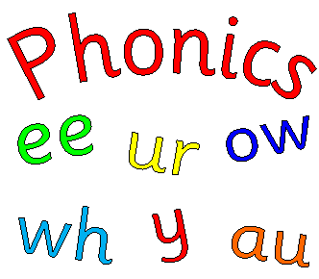
Section 1 (20 words)
lig mep gax emp (simple cvc or vcc words)
beff shup doil charb (cvc – vowel digraphs0
frex criff haps barst (consonant clusters)
chin deck horn queen
tram press self keeps (consonant cluster + tense)
Section 2 (20 words)
jigh woats rird phope (trigraph and split digraph)
glips floost splam stribe (longer consonant clusters and spilt digraphs)
stair haunt lied wove
drank treats scram stroke
arrow forest wishing brighter (polysyllabic and best bet words)

Slide 7
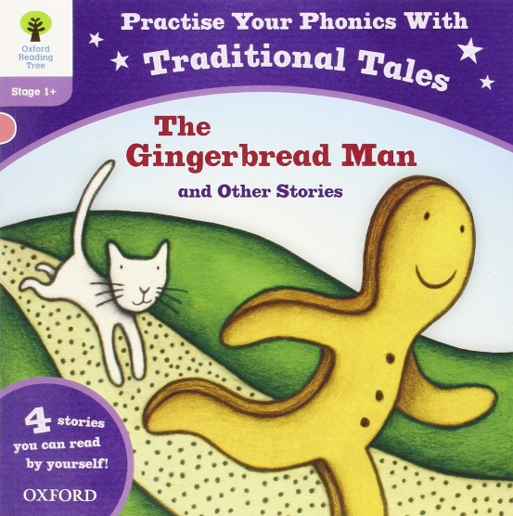
Improvements in Phonics check and KS1 reading results Does your long-term planning include all the elements of the test? Consonant clusters, split digraphs, polysyllabic words, pseudo words and past tense verbs - as well as Phase 5 phonemes?
Daily (even in Year 2) – carefully planned, fast paced, 4 part lessons
Delivered by a teacher, supported by TAs (keep it in the classroom, where you can oversee!)
Planned opportunities for over-learning
Key strategies taught regularly
Planned preparation for the test in Year 1 and 2
Phonics everywhere – go sound button crazy!
Getting parents on board
Resources
Reading Schemes
Cross-curricular links and links to SPaG, Handwriting and Guided Reading

Slide 8
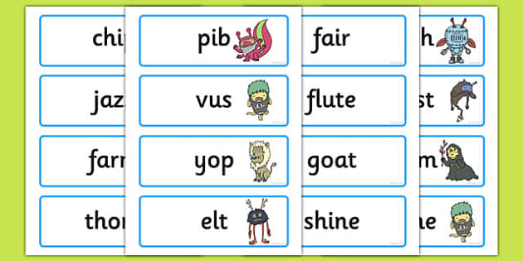
Targeting under-performing groups
Summer born boys (7% gap in 2016)
SEND
Dyslexia
Working Memory
Autistic Spectrum
Glue Ear/Grommets
EAL (Roma/Traveller)
FSM
Strategies include – Teacher led, Overlearning, Pre-teaching, Kinaesthetic activities that combine oral, physical and aural approaches, Linking phonics to fine-motor skills, Bumping into Phonics, Sound Buttons everywhere, Reading books and all reading matter at relevant phases, Practice materials and strategies, Teaching linked to interests.
Will your scheme match their needs?

